Slide 1
Simulation Programming Task

Slide 2
The general tasks involved in preparing a computer program for a simulation are:
i) Generate model
ii) Simulate
iii) Report
The first step is to generate a model and initialize it. From the description of the system, a set of numbers must be created to represent the state of the system.
This set of numbers are called system image since its purpose is to reflect the state of the system at all times.
The activities of the system must be represented as routines that create the discrete events making the changes to the system image.
The second step is to program the procedure that executes the cycle of actions involved in carrying out the simulation. This procedure is referred to as the simulation algorithm.
The third task is the generation of an output report. The statistics gathered during the simulation will usually be organized by a report generator.
This set of numbers will be called the system image since its purpose is to reflect the state of the system at all times. The activities of the system must be represented as routines that create the discrete events making the changes to the system image.

Slide 3
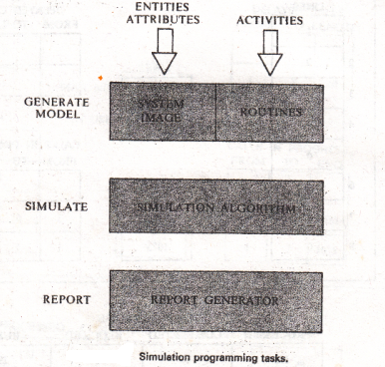

Slide 4
The general flow of control during the execution of a simulation program is shown in the flowchart.
At the top of the figure is the task of generating the model, which is executed once.
At the bottom is the report generation task, which is usually executed once at the end of the simulation.
Carrying out the simulation algorithm involves repeated execution of the five steps.
These are:
i) Find the next potential event.
ii) Select an activity.
iii) Test if the event can be executed.
iv) Change the system image
v) Gather statistics
If the test be made at step 3 finds that the event due to occur can not, the event is to be executed later, when conditions are suitable, it is said to become a conditional event.

Slide 5
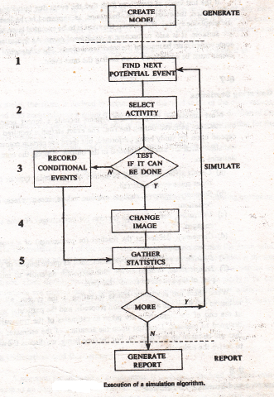

Slide 6
Gathering Statistics
Most simulation programming systems include a report generator to print out statistics gathered during the run. The exact statistics required from a model depend upon the study being performed, but there are certain commonly required statistics which are usually included in the output. Among the commonly needed statistics are:
Counts giving the number of entities of a particular type or the number of times some event occurred.
Summary measures, such as extreme values, mean values, and standard variations.
Utilization, defined as the fraction of time some entity is engaged.
Occupancy, defined as the fraction of a group of entities in use on the average.
Distributions of important variables, such as queue lengths or waiting times.
Transit times, defined as the time taken for an entity to move from one part of the system to some other part.

